Slide 1

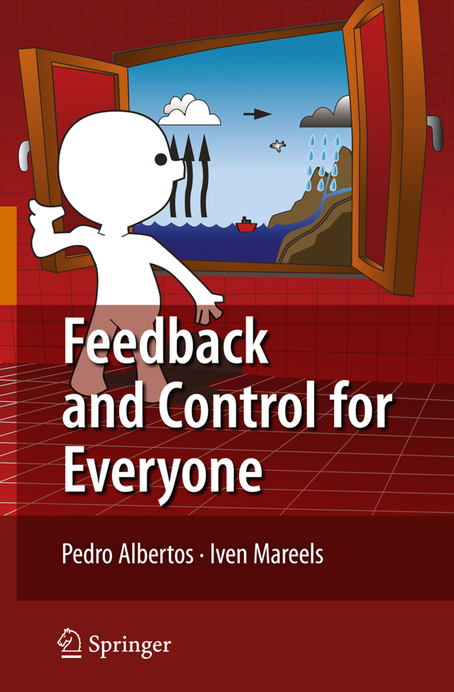
Iven Mareels
Dean
Melbourne
School of Engineering

Slide 2
Objective
Introduce the notion of “systems thinking”
Illustrate the potential of “feedback & control”
Demonstrate the role of mathematics and computation in engineering design

Slide 3
Example our water “system”
cities
Water System
leisure
industry
agriculture
environment
Measure
Model
Manage
Spatial and temporal scale
economics
infrastructure
public health
policy
rights

Slide 4
Outline
“Lecturing” from a systems point of view – introducing systems language
Models & prediction – modelling water flow in a channel
Feedback & control for water distribution

Slide 5
“Lecturing” A Systems Point of View
Slides, Speech,
Body language
The Lecturer
System (box in a system diagram)
= Object that takes actions, produces, transforms “things”
Signals (arrows in a systems diagram, connected to systems)
= Things observed or used by a system (inputs); or produced
by or measured from a system (outputs); the arrows matter!
= a function of “time”
Causality, precedence and time play key roles in the study of
systems!

Slide 6
Lecturing: A Systems Point of View
Speech, Slides,
Body language,
Noise, …
The Audience
Body language
Questions,
Noise …

Slide 7
Lecturing: A Systems Point of View
Environmental
noise
Slides, Speech,
Body language
The Lecturer
The Audience
Body language
Questions,
Noise
Environmental
noise

Slide 8
Lecturing: A Systems Point of View
Environmental
noise
Slides, Speech,
Body language
The Lecturer
A loop of signals and systems = feedback
The Audience
Body language
Questions,
Noise
Environmental
noise

Slide 9
Lecturing: A Systems Point of View
Other party instructions
Environmental
noise
Slides, Speech,
Body language
The Lecturer
The Audience
Body language
Questions,
Noise
Environmental
noise
Other party instructions

Slide 10
Signals & Systems
A way of focusing on what matters (to you)
Signals = functions of time, observable or measurable (by you)
Systems = act on signals, produce signals (defined by, defining the signals)
System diagram = a way of communicating, capturing the interaction, connectivity, relationships between systems and signals, separating the environment from “what matters”
A system diagram is always a partial or incomplete description, there is no unique representation

Slide 11
Outline
“Lecturing” from a systems point of view – introducing the language and the diagrams
Models & prediction – modelling water flow in a channel
Feedback & control for water distribution

Slide 12
Models, prediction, simulation
Systems with their signals can be considered in isolation; to simplify, we divide and conquer; consider sub-systems with their signals
Models (explaining the behavior; what is possible, and what is not)
= mathematical or computational description for the (sub)system/signals
= enables simulation & prediction (& further design)
Modelling – the art & science of obtaining a model
Step 1 – what is the physical reality, system? Step 2 – what do I need to capture in the model? Step 3 – determine, validate model (for a purpose)
Control – the art & science of designing a system’s behavior
Example manage water distribution in open channels (say for irrigation purposes) i.e. deliver water orders; a river is not a tap

Slide 13
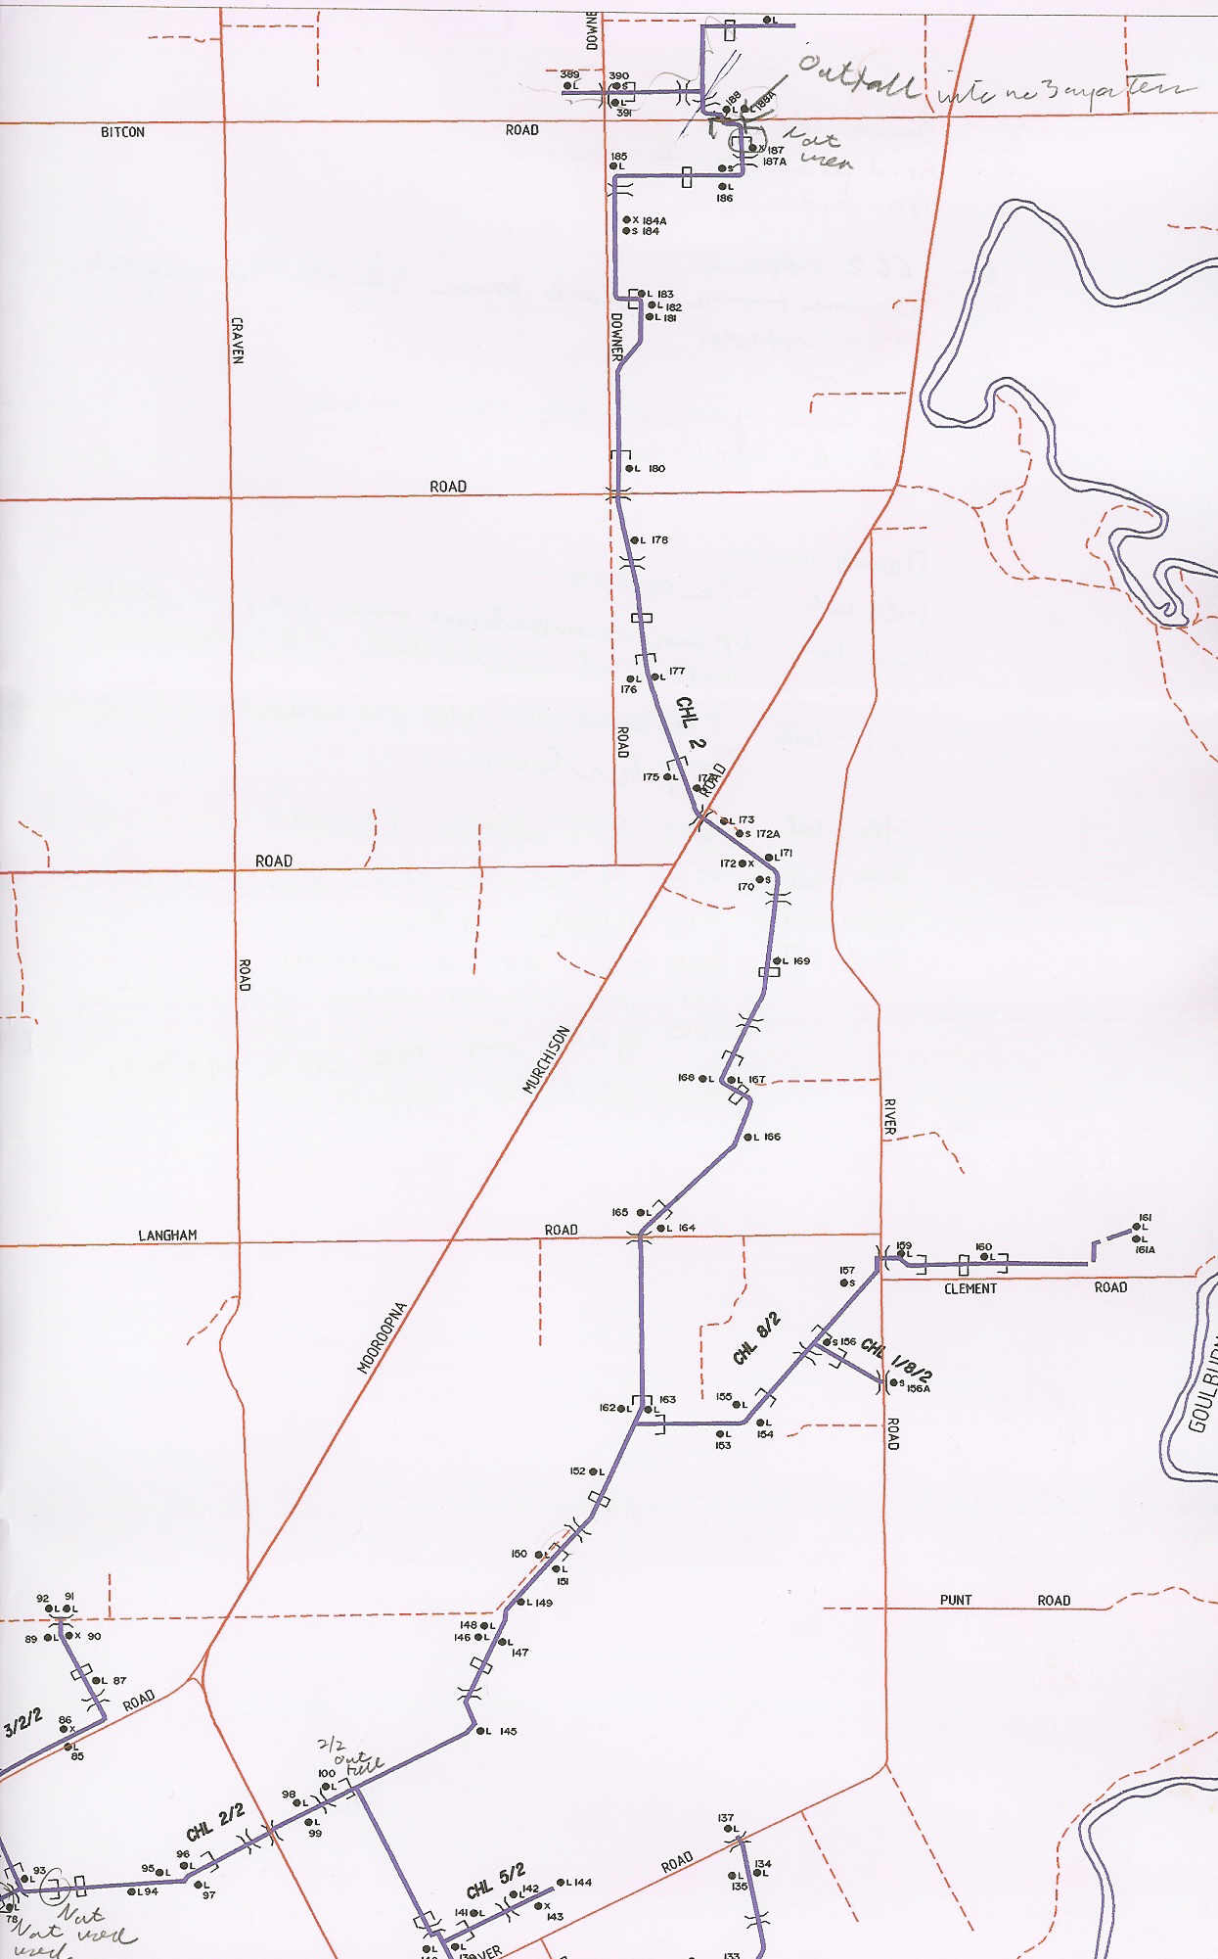
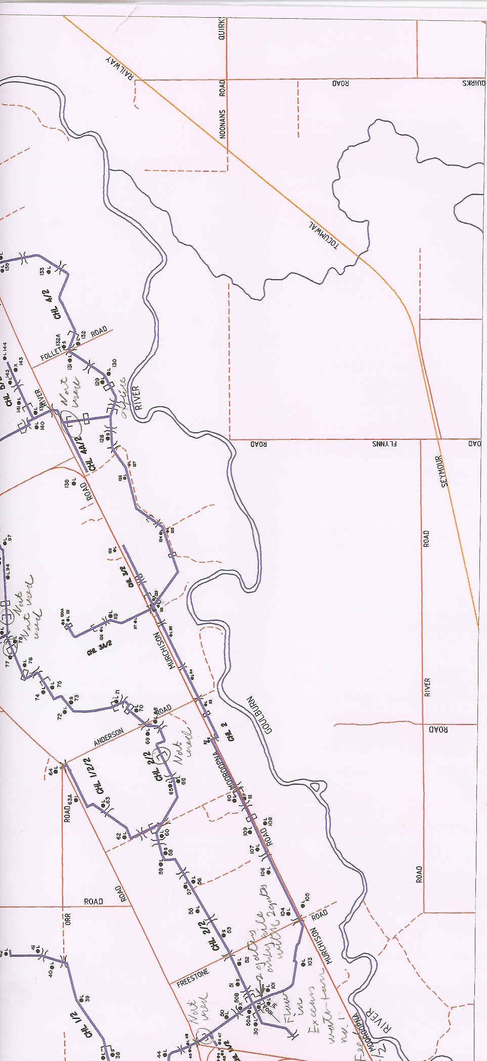
CG2 Irrigation Map
74 km of main canal
33 regulators, 11 outfalls
156 farm outlets ( >50 m³/s compare with 2 m³/s inflow capacity)
allocation 110Mm³ p.a. = 0.5m rain over area
Fully autonomous operation since 2002
outfalls
No 1
An example of water distribution in an open channel

Slide 14
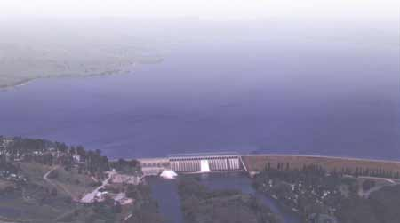
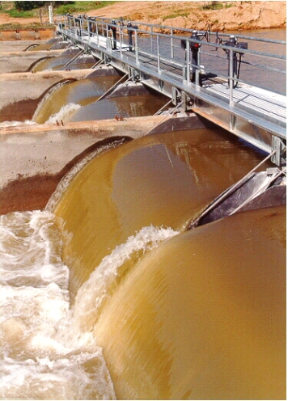
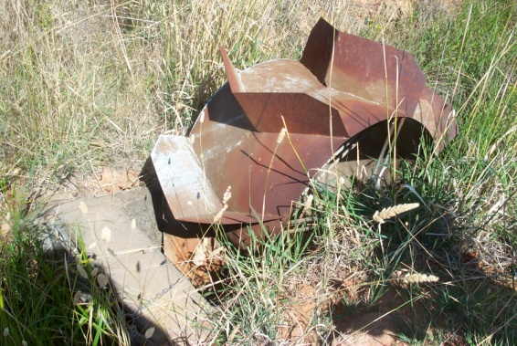
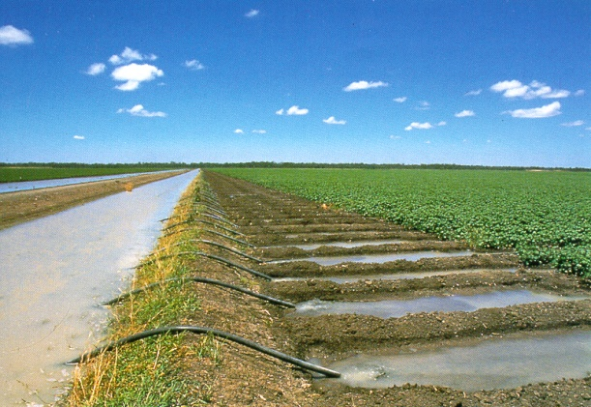
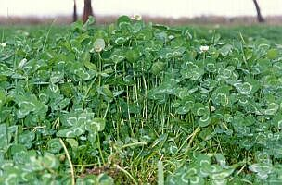
Irrigation using gravity
Efficiency < 50%
Over-irrigation leads
to soil degradation
Poor accountability
Dam evaporation ≈ 10%
Dam release 100
Metering
error
± 20%
Channel
to farm
consumes
>30
Seepage ≈ 5
Evaporation≈ 5
Outfalls> 5
Conservative over
supply (due to the
above ≈ 15)
Outfalls ≈ 15
Seepage ≈ 15
Plants ≈ 40
Farm gate to plant
consumes 30
Low energy footprint
More productive, more reliable farming
50% of all farm profits (on a small area)
Farmers take all risk, ask for more water
Plants store (1%)
0.4

Slide 15
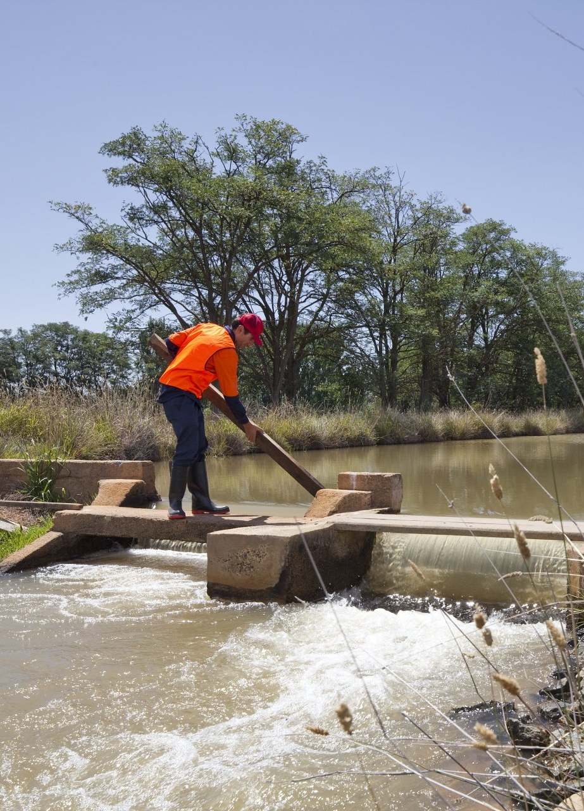
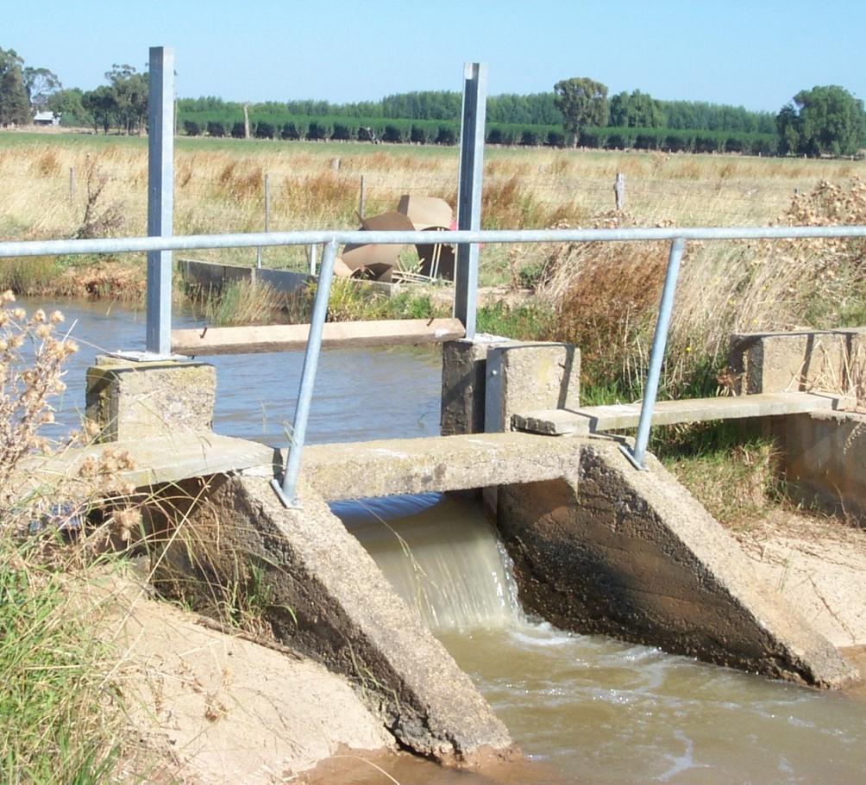
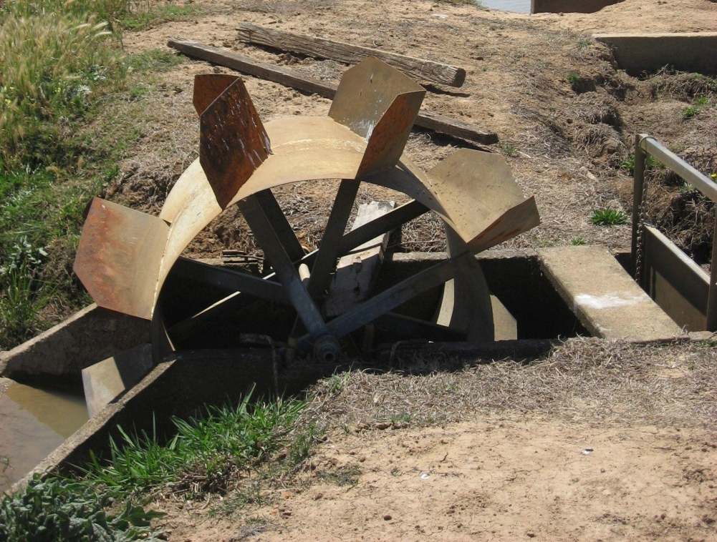
Typical manual control

Slide 16
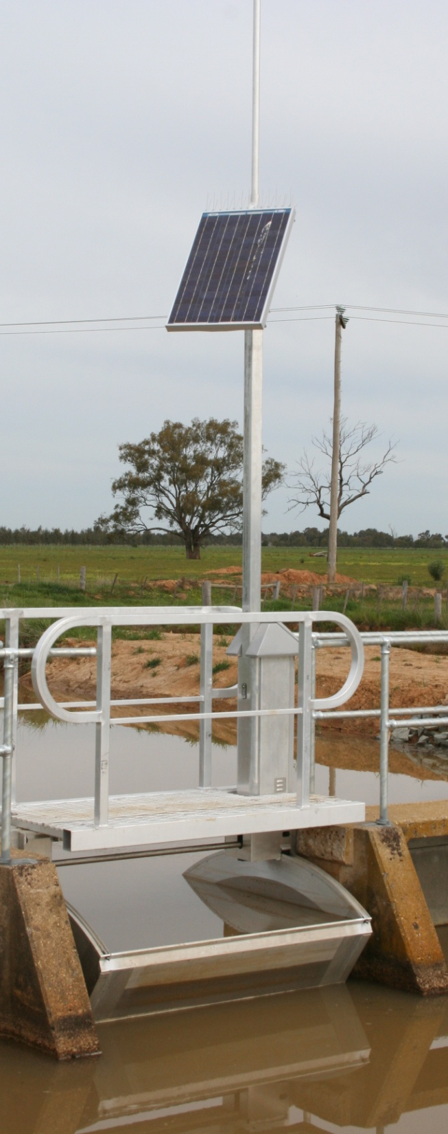
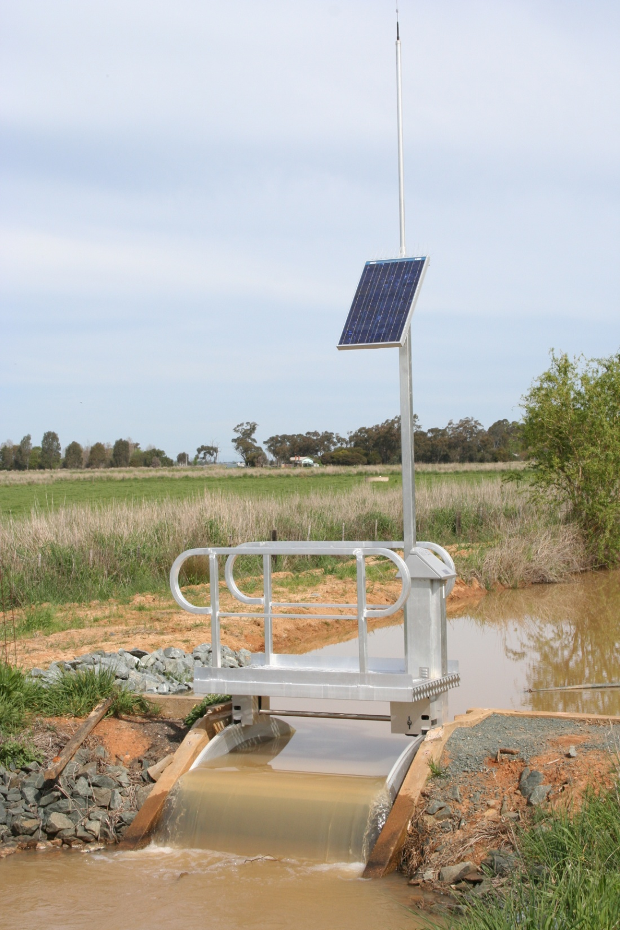
In-Channel
Actuator & Sensor
The FlumeGate™
Modern
Automated
Control
Rubicon Water Pty Ltd,
Melbourne
Water tight, self cleaning, low head loss flow actuator (system)
Accurate, repeatable
self calibrating flow and level sensor (system)
(SKM, THIESS 2009 <+/- 2%)
Radio based internet, 1 PC on board (remote sensing, actuation)
Solar powered, 4 day battery back-up
64 tagged variables per unit

Slide 17
Models, prediction, simulation
Systems with their signals can be considered in isolation
  Simplify: divide and conquer: consider sub-systems & signals
Models
= mathematical or computational description for the system/signals
= enables simulation & prediction
Modelling – the art of obtaining a model
Step 1 – what is the physical reality, system? Step 2 – what do I want to capture in the model? Step 3 – determine, validate model
Example manage water distribution in open channels (say for irrigation purposes) i.e. deliver water orders; a river is not a tap

Slide 18
Model: pool by pool, regulator by regulator
Pool = canal section between regulators
Length varies from 1km – 10km
Water flow wise cross section:
Off take
Off take close to
pivot point
Water level for high flow
Water level for no flow
Canal slope ≈1/10,000
Datum level may not be
unified across system

Slide 19
Building Large Scale Model
Pool model = from up-stream inflow to down-stream water level, with a downstream flow disturbance (off-take)
Inflow u, water level y, off-take v, τ delay = actions travel time on pool – simple mass balance model is:
Sensor i
upstream pool i
. . .
Pool i -1
. . .
-
Pool i
-
+
+

Slide 20
Models, prediction, simulation
Systems with their signals can be considered in isolation
  Simplify: divide and conquer: consider sub-systems & signals
Models
= mathematical or computational description for the system/signals
= enables simulation & prediction
Modelling – the art of obtaining a model
Step 1 – what is the physical reality, system? Step 2 – what do I want to capture in the model? Step 3 – determine, validate model
Example manage water distribution in open channels (say for irrigation purposes) i.e. deliver water orders; a river is not a tap

Slide 21
Step 1: determine model parameters
delay time, gate geometry,
pool dimensions
must use field data
three different models identified
24.03
24.01
23.99
23.97
Identification
data set
Water level (mAHD)
23.95
23.93
23.91
23.89
Time (min.)
200
220
240
260
280
300
320
340

Slide 22
Step 2: validate model parameters
predict water level into the future
given gate positions, and past water
levels
- check against new measurements
24.03
24.01
23.99
23.97
Validation
data set
Water level (mAHD)
23.95
23.93
23.91
23.89
Time (min.)
200
220
240
260
280
300
320
340

Slide 23
The Art and Science of Modeling
The aim of modeling:
For a given set of data (= data complexity), there is an optimal (= best utility) model complexity
Utility
Model
complexity
Data
complexity
optimal data complexity –
optimal model complexity

Slide 24
Outline
“Lecturing” from a systems point of view – introducing the language and the diagrams
Models & prediction – modelling water flow in a channel
Feedback & control for water distribution

Slide 25
Applications
Decision Making
Policy
Economics
Network op’s
Systems Engineering
Middleware
Data to Information
Modelling
Control: what to do?
Hardware
Data Acquisition
Sensors/Actuators
Communications
Computing
Information feedback loop
The issues are
Time scales / spatial scale
Complexity

Slide 26
The Ingredients of an Autonomous System
Sensors - monitor data; event driven, report by exception (distributed across the civil infrastructure)
Actuators - enable real time action, change topology of civil network (distributed across the civil infrastructure)
Computers & storage – combine prior knowledge with, sensor data, and decide actuation based on external objectives and present situation
Communication system – sensors to actuator via brain
Design – systems engineering & control, coordinate the assets to respond to management needs
1 to 5 approximates autonomous system behaviour
similar to a “human body”

Slide 27
Control for Water Distribution
Maintain water levels, deliver water orders, minimise outfalls, cope with the weather, seepage, evaporation losses …
An irrigation district in Australia = 30,000 pools with 10-15 action events/h ≈ 7M “SMS” per day
Need to integrate these data with weather data, crop data, asset condition data, economic data (value of crop) to provide decision support for best result for irrigation
“actuator/sensor infrastructure” + “telecommunication infrastructure” + “software” = control system in support of the civil infrastructure, the whole delivers a “water service”

Slide 28
System thinking: how to do control
System
of interest
What is measured
Inputs
The inverse
model
What is desired
Inverse problems are
normally HARD

Slide 29
System thinking: how to do control
Disturbances
System
of interest
What is measured
Feedback is
needed to
take care of
“errors”
Actions
“An” inverse
“model”
Inverse problems are
normally HARD
What is desired

Slide 30
Global radio
information
Global radio
information
Control
design
Control
at gate
i-1
Control
at gate
i
Local radio
communication
Sensor i
upstream pool i
Sensor i+1
upstream pool i+1
. . .
Pool i -1
. . .
-
Pool i
-
+
+
Civil
infrastructure
design

Slide 31
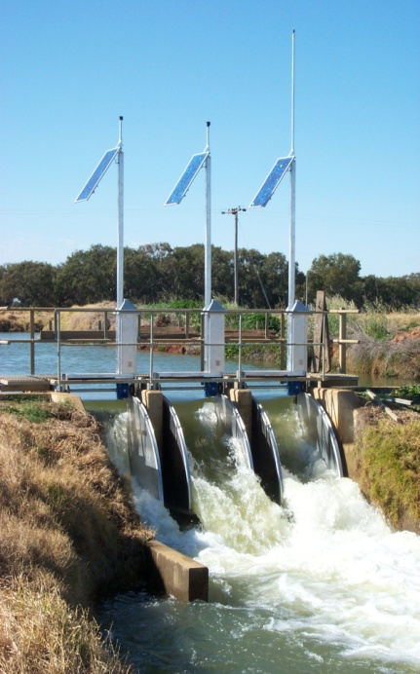
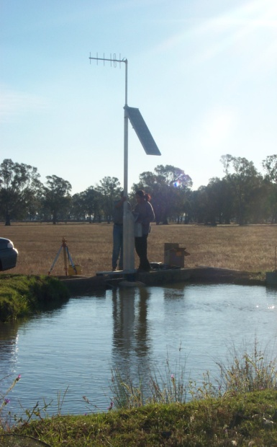
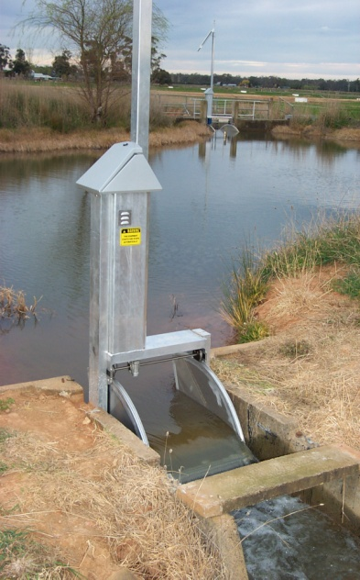
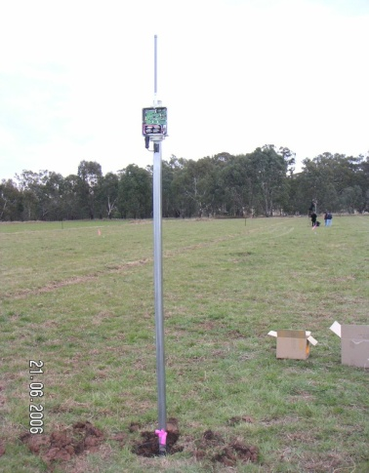
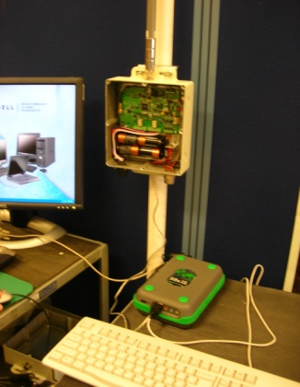
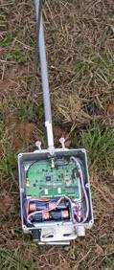
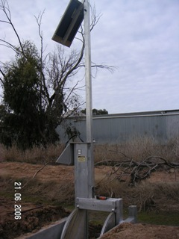
Central
node
Channel System
Commercial
Regulator
main
Gate
Water managed from reservoir to plant
feedback loop from the crop condition
for more “crop per drop”
Precision farming
Farm nodes

Slide 32

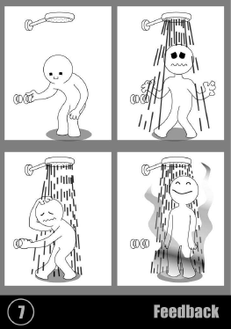
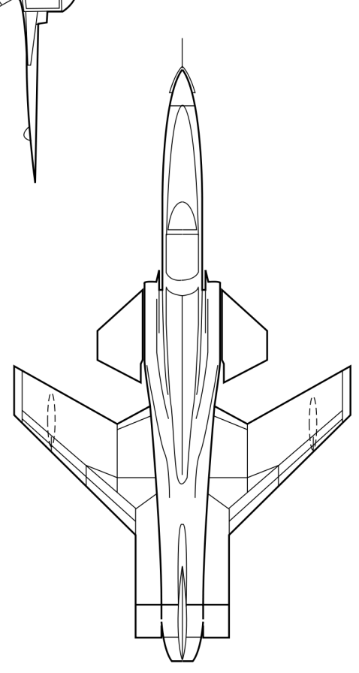
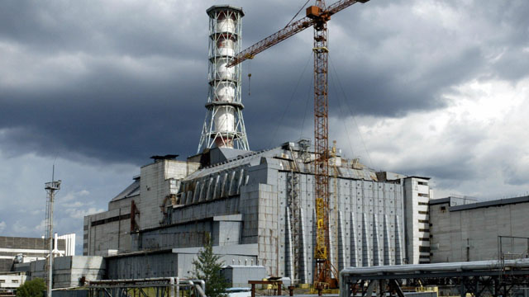
Feedback needs design
Unpleasant feedback experiences
Acoustic feedback
Hot/cold shower
Amplifier
Abandoned feedback experiences
Forward swept wing aircraft
Disastrous feedback experience
Chernobyl runaway reactor

Slide 33
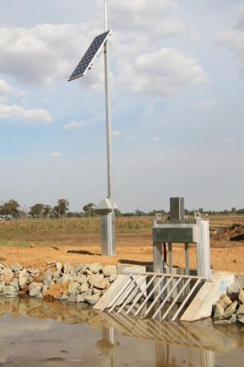
Dam evaporation ≈ 10%
Dam release 100
Efficiency > 80% not < 50%
Improved accountability
Meter
error
± 2%
Channel
to farm
consumes
10 30
Seepage ≈ 5
Evaporation ≈ 5
Outfalls≈ 5
Conservative
management ≈ 15
x
x
Outfalls ≈ 0 15
Seepage ≈ 10 15
Plants ≈ 80 40
x
x
Farm gate to plant
consumes 10 30
x
Plants store (<1%)
<0.8
Double the production for
the same water volume
Farmers ask for less water

Slide 34
1st pool on CG2
01.01.2005
Down stream
water level error
(cm)
Water demand
Ml/day (m³ /s)
8
115 (1.4)
4
95 (1.1)
0
75 (0.8)
-4
55 (0.5)
-8
Time (h)
0
5
10
15
20
25
287 “measurement events” ≈ 5min between measurements
1 gate movement / 10min

Slide 35
To probe further
Systems & signals: properties, classify, order, construct, design for…
Control design = augmenting systems, use feedback, design by optimization (find best possible)

Slide 36
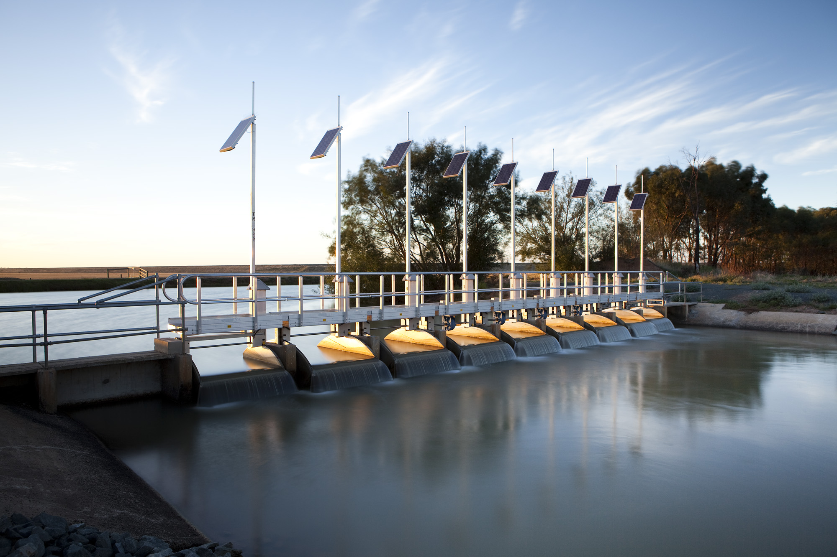
Thank You & Discussion
Measure
Model
Manage

Slide 37
Another example: the hydrocycle
Ocean
Rain
Atmosphere
Evaporation
Transpiration
Evaporation
Transport
Precipitation
Evaporation
Soil &
Plants
Run-off
Ice, dams, rivers, lakes
Rain,
precipitation
Percolation

Slide 38
Another example: the hydrocycle
Solar
energy
Ocean
Rain
Atmosphere
Evaporation
Transpiration
Evaporation
Transport
Precipitation
Evaporation
Soil &
Plants
Run-off
Ice, dams, rivers, lakes
Rain,
precipitation
Percolation

Slide 39
Another example: the hydrocycle
All flows in
1,000 km³/year
Solar
energy
Ocean
373
Atmosphere
413
40
113
73
Soil &
Plants
Ice, dams, rivers, lakes
Land mass

Slide 40
Another example: the hydrocycle
What are some of the things missing in this picture?
Solar
energy
Ocean
373
Atmosphere
413
40
113
73
Soil &
Plants
Ice, dams, rivers, lakes
Land mass

Slide 41


2003
2005
2009
Crisis “Water management crisis”, “Water efficiency < 50%”, “Paucity of data”, “Poor quality data - everywhere”
Getting worse: equity, industrialisation, food & irrigation (70% of all water), climate change, population growth, environmental needs
60% of “easy” (run-off) water is in use
95% of all river basins are severely over-exploited

Slide 42
Water Time Scale Complexity: 12 orders of magnitude
From seconds to millennia
but we do not know much about it!
Ground
water
Regional planning
Infrastructure
sustainability
Farm
planning
10⁻⁵
10⁻⁴
10⁻³
0.01
0.1
1
10
100
1000
year
Water allocation
policy framework
Water distribution
The hydro cycle(s)

Slide 43
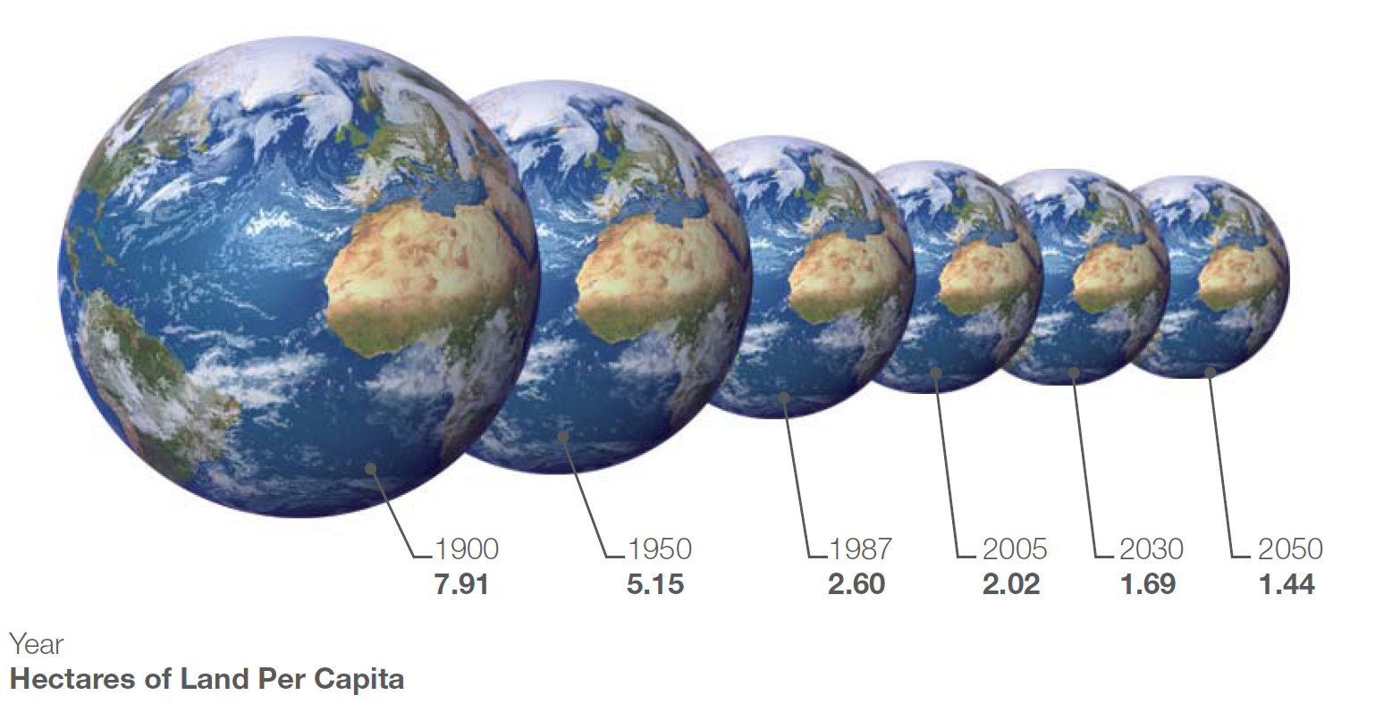
Human activities are “earth-sized” processes
We should manage on this scale
Water Spatial scales from the molecular to the planetary
= 16 orders of magnitude
http://maps.grida.no/go/graphic/our-shrinking-earth

